Slide 1

Light Amplification by Stimulated Emission of Radiation - LASER: The SuperTool of the 20th century

Slide 2
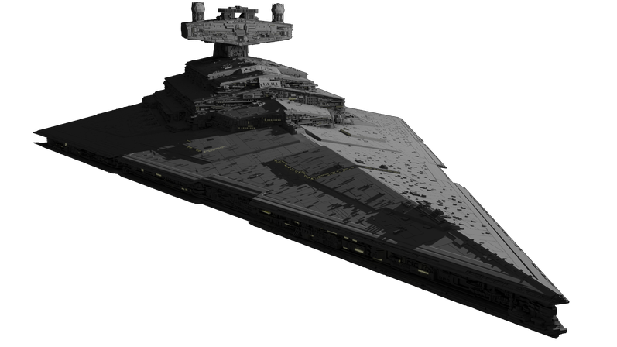

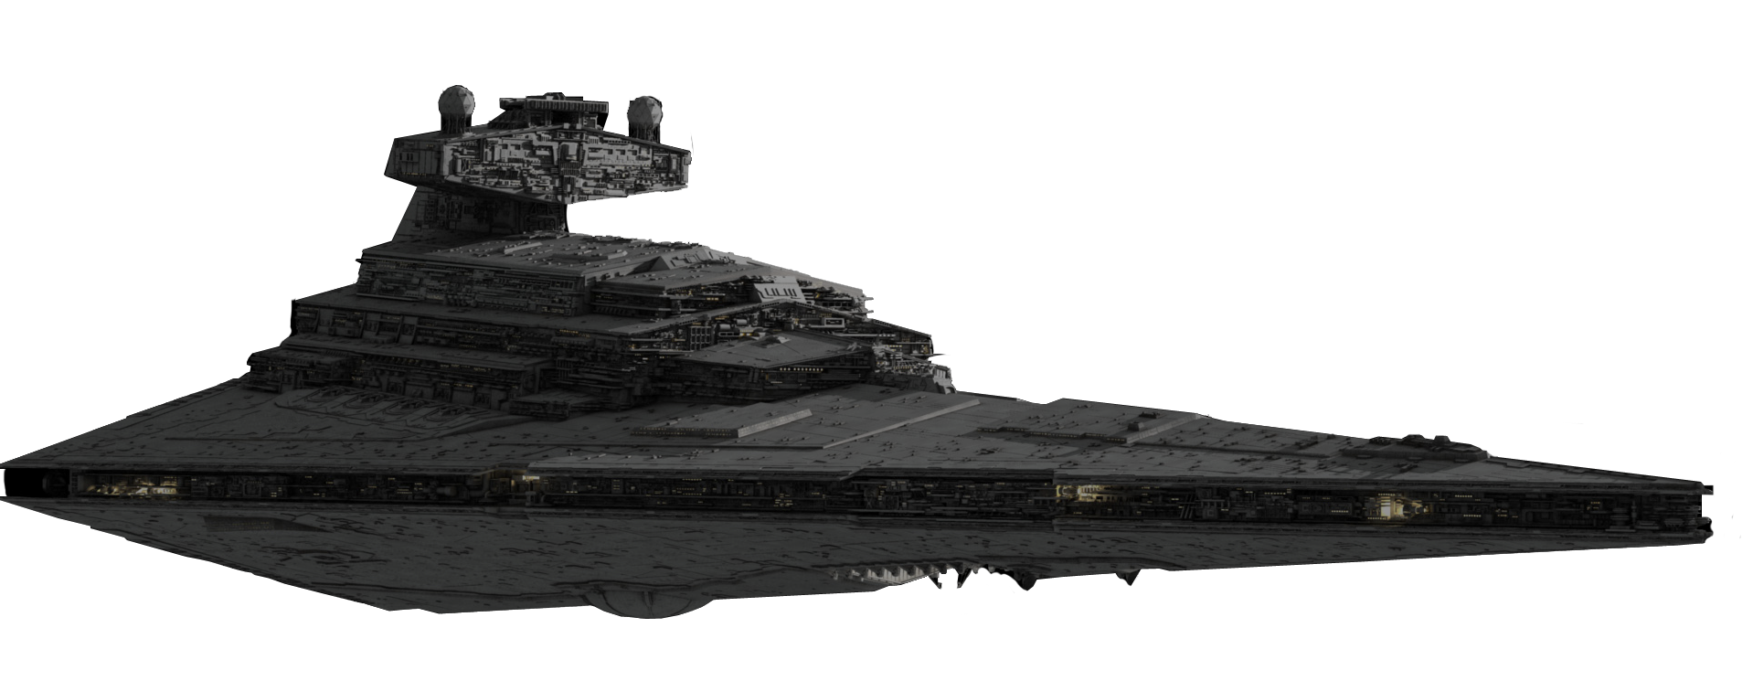
LASER: The SuperTool of the 20th century

Slide 3
Presentation plan
What is laser?
Characteristics of lasers
Main types of lasers
Areas of application of lasers
Further development of lasers
Conclusion

Slide 4

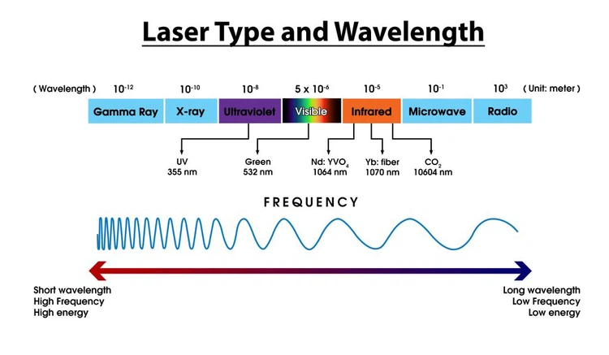
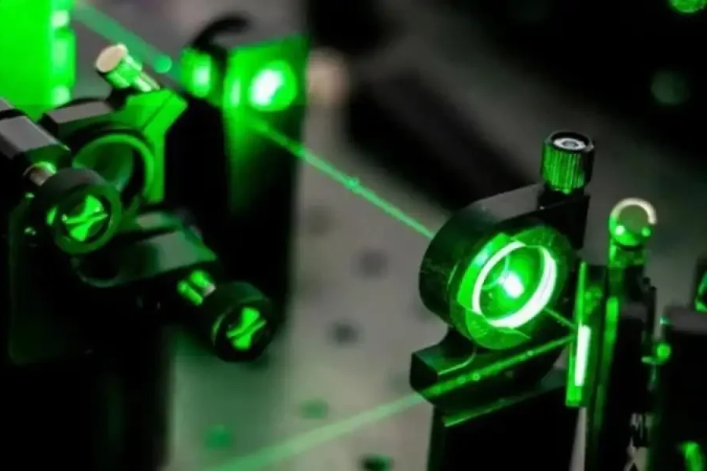
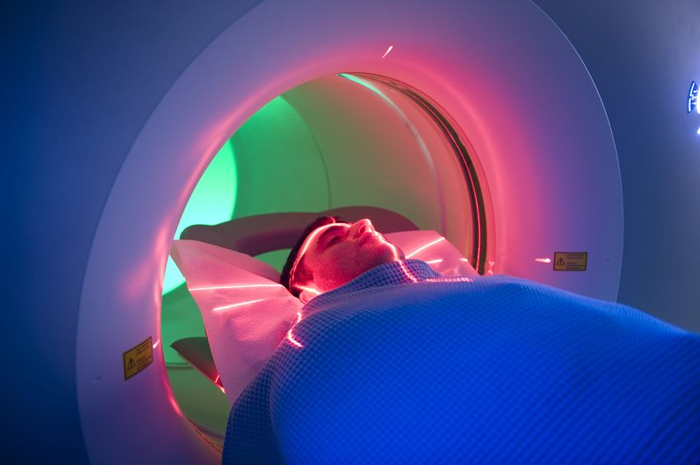
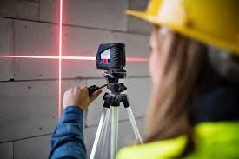
What is laser?

Slide 5
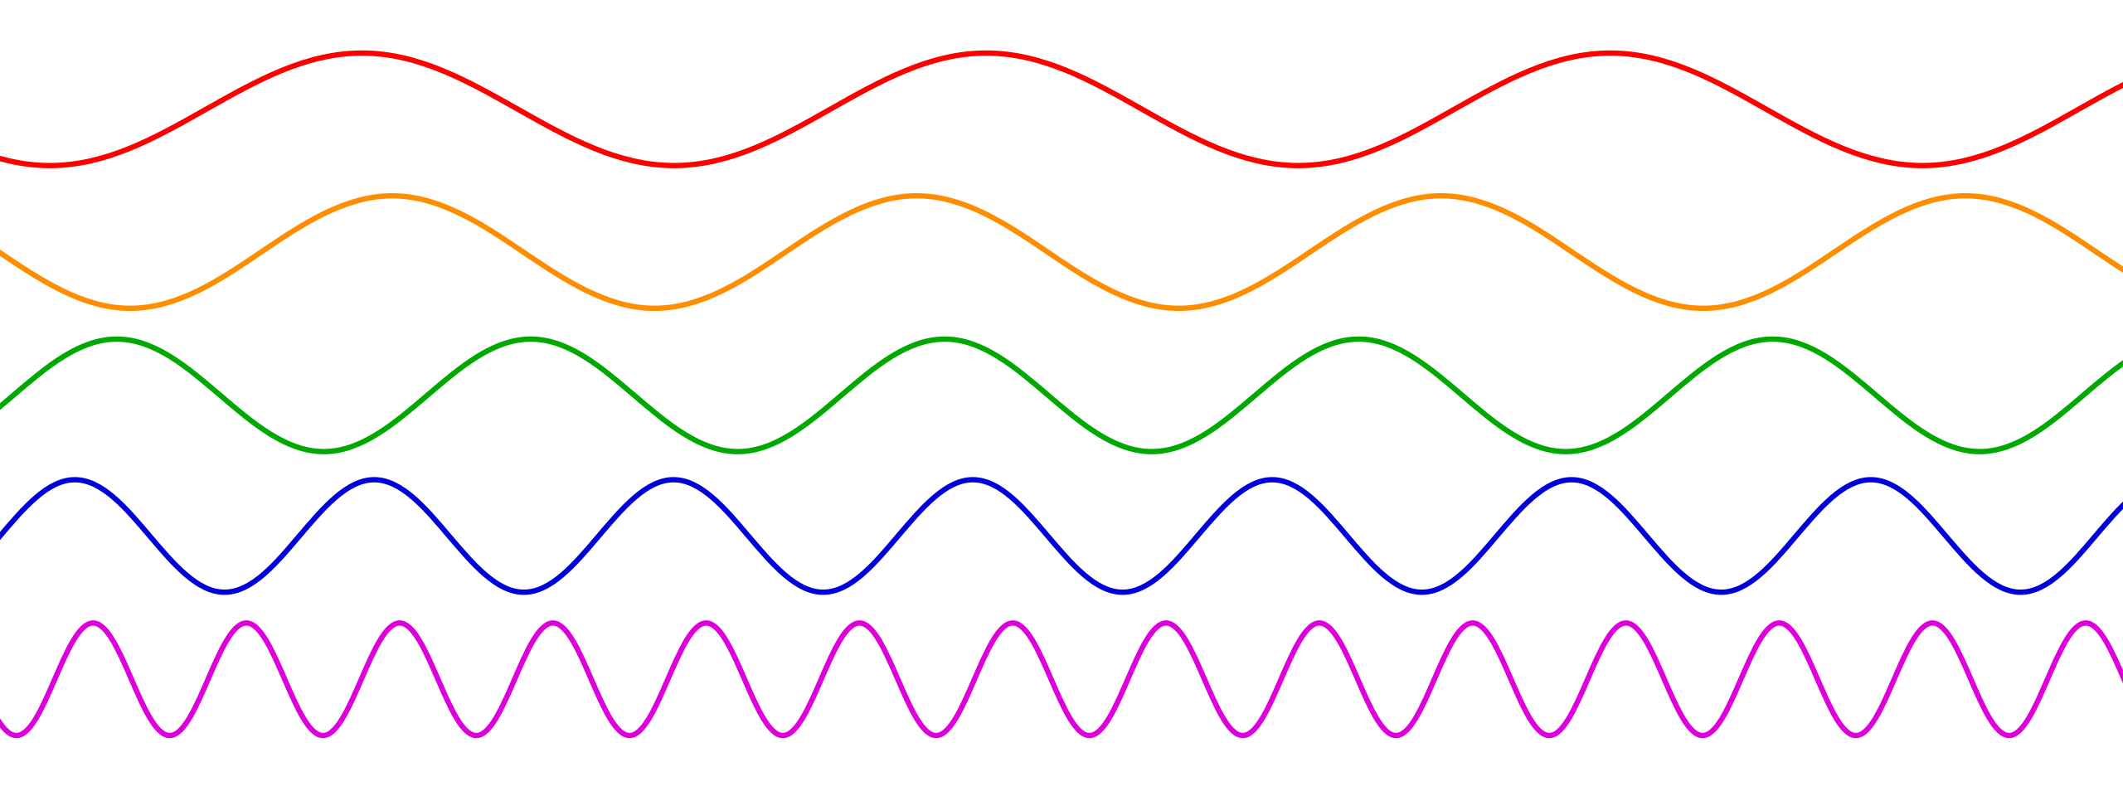
Characteristics of lasers
Coherence
Monochromaticity
Directionality
Intensity

Slide 6

Main types of lasers
Solid lasers
Gas lasers
Liquid lasers
Semiconductor lasers

Slide 7
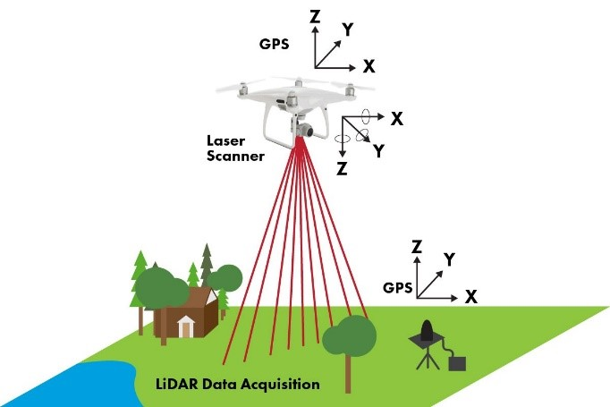
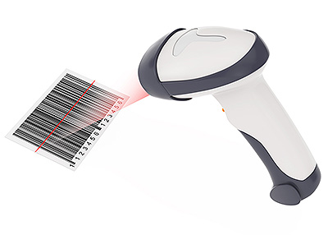
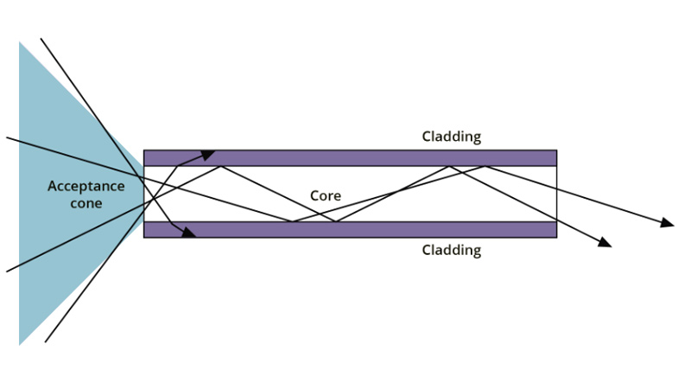
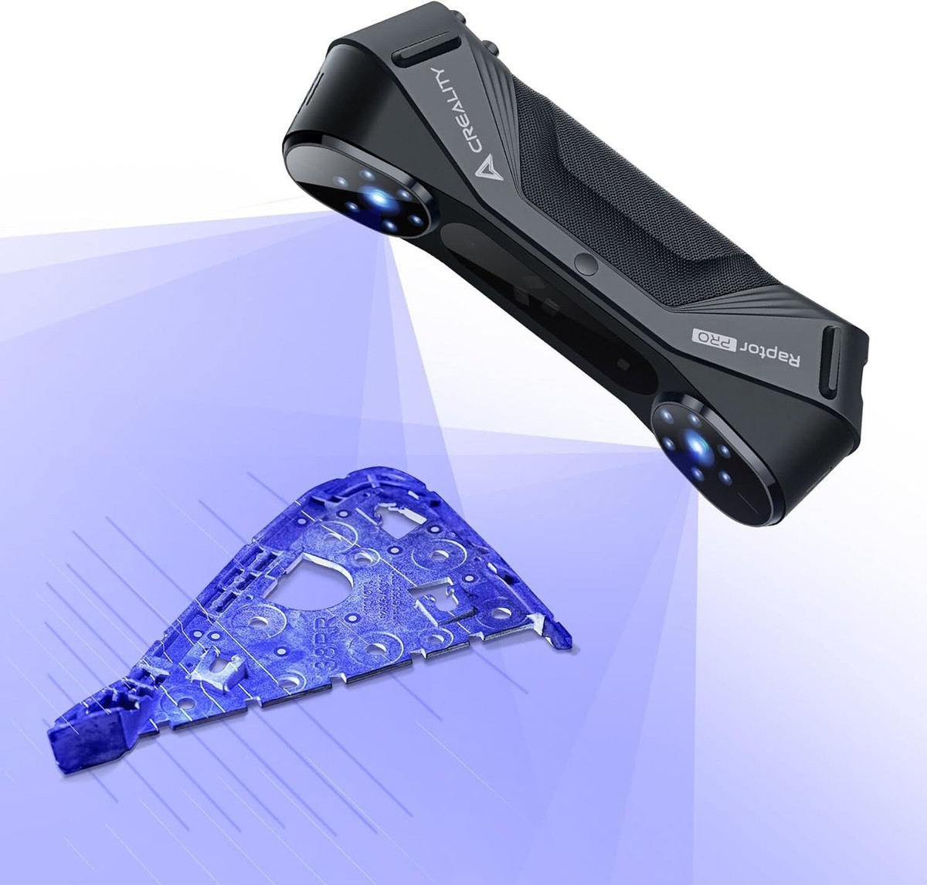
Areas of application of lasers
Medicine
Science
Information Technology
Industry

Slide 8
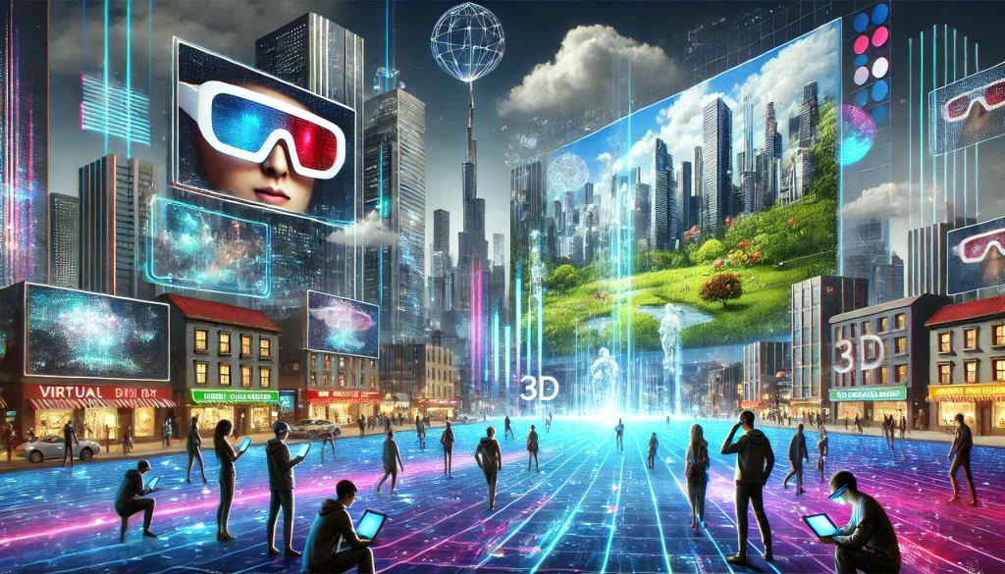
Further development of lasers

Slide 9

Conclusion

Slide 10
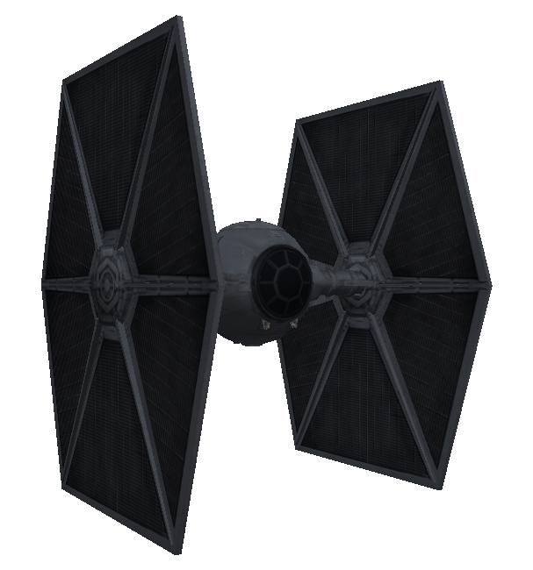
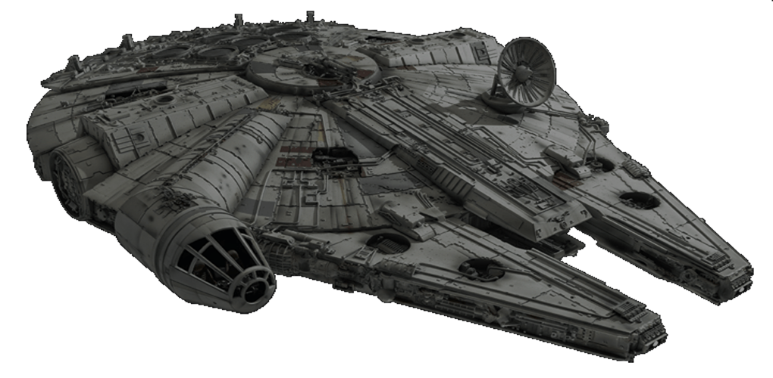
Thank you for your attention!

